Slide 1

CIT83104: ADVANCED WEB DESIGN AND DEVELOPMENT
By:
Mr. MANIRARORA Jean Marie Vianney
Course Code: CIT83104 & Name: ADVANCED WEB DESIGN AND DEVELOPMENT
1

Slide 2
CLASS INSTRUCTIONS
Please keep your phones aside during class sessions.
100% attendance is required for all classes.
Students are expected to practice effective time management.
Participation in all academic activities is mandatory, including:
Quizzes
In-class activities
Individual assignments
Group assignments
Presentations
Note: Failure to attend or participate in these activities may affect your overall performance.

Slide 3
MODULE OVERVIEW
Module Code: CIT83104
Title: Advanced Web Design and Development
Credits: 15
Year: 3rd Year
Prerequisite: Introduction to Web Design and Development
Total Study Hours: 150 (Lectures, Labs, Assignments, Self-study, etc.)

Slide 4
MODULE AIMS
Prepare students for professional web development
Blend theoretical knowledge with practical implementation
Focus on interactive, database-backed, and maintainable web applications

Slide 5
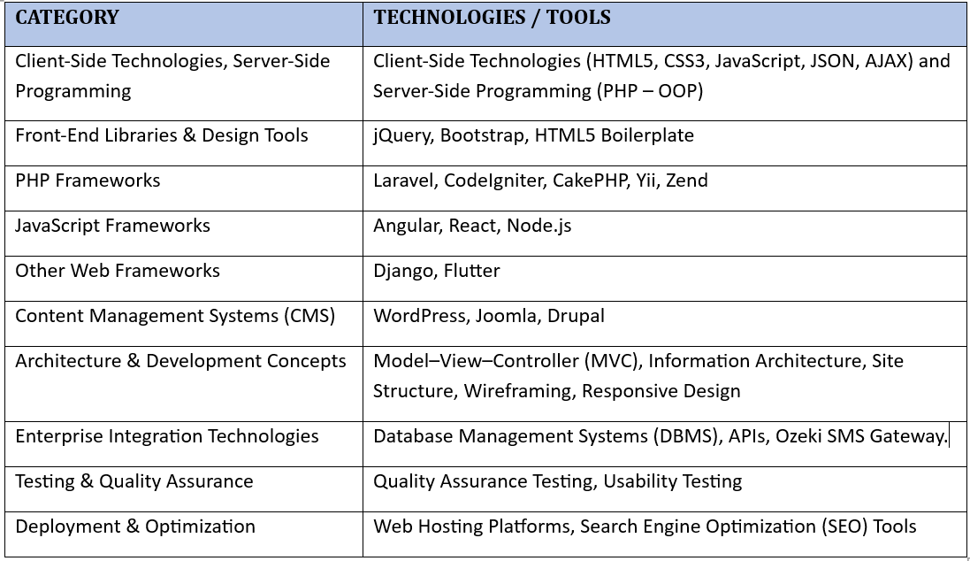
KEY TECHNOLOGIES & TOOLS

Slide 6
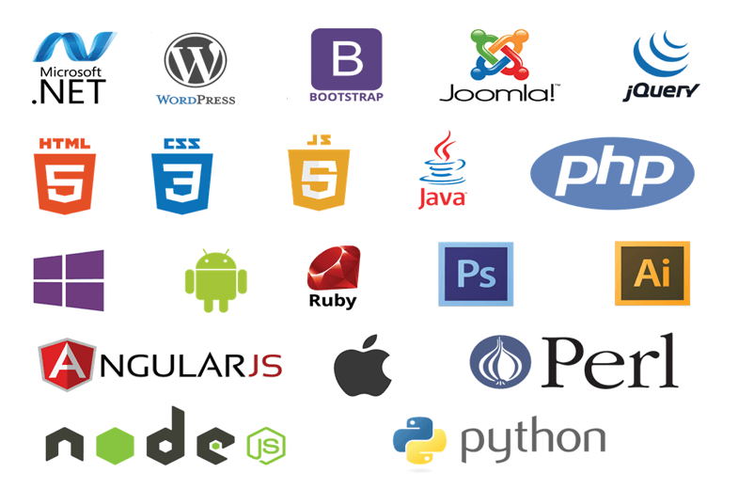

Slide 7
MODULE CONTENTS
HTML, CSS, JavaScript, layout techniques, and other industry-standard practices.
Scripting technologies to create dynamic and interactive websites.
Professional quality portfolio of web design work.
Back-end interactivity with front-end to build web applications
Build Dynamic websites utilizing the most current versions of industry-standard applications and tools

Slide 8
CHAP 1: APPLY HTML, CSS, JAVASCRIPT, AND LAYOUT TECHNIQUES

Slide 9
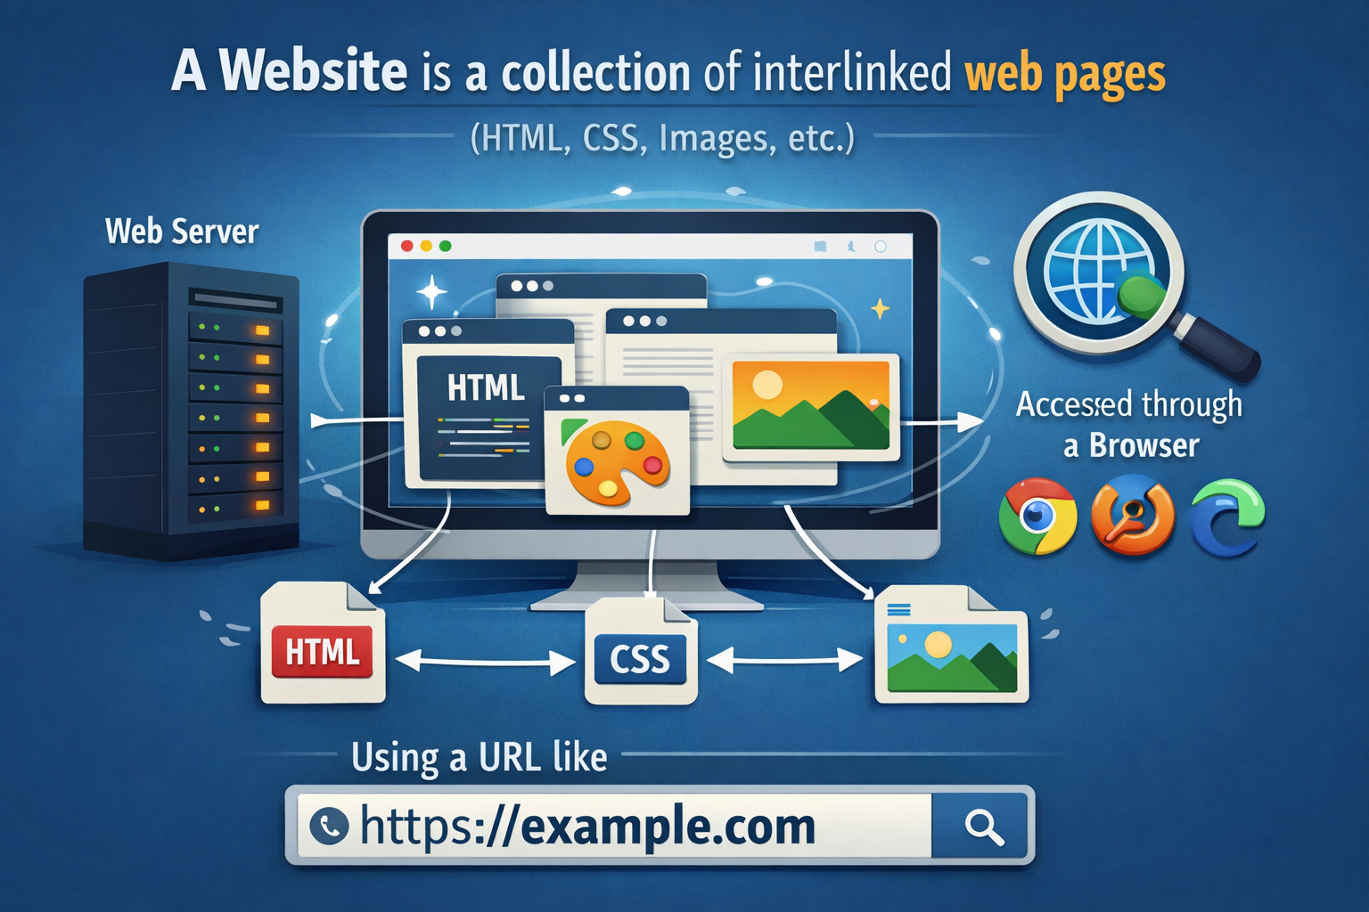
INTRODUCTION
DEFINITION OF KEY CONCEPTS
1. A website is a collection of interlinked web pages (like HTML, CSS, images, etc.) that are hosted on a web server and accessed through a browser using a URL like https://example.com.
Key Features:
Mainly static (HTML/CSS only)
Includes content like text, images, and links
Often used for displaying information (blogs, news, company profiles)
Examples:
A personal portfolio site
An online school homepage
A news site like https://www.bbc.com

Slide 10

2. A web application: is an interactive website that performs functions based on user input, processes data using server-side scripts, and often interacts with databases.
Key Features:
Dynamic and data-driven
Users can log in, input data, and get customized output
Built using both front-end and back-end technologies
Examples:
Gmail (sending and receiving emails)
Facebook (social networking)
Online banking systems

Slide 11
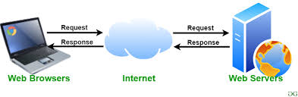
3. A Web Server
A web server is software (and/or hardware) that:
Receives and processes HTTP requests from browsers
Delivers web pages and web applications back to the browser
Functions:
Hosts website files (HTML, CSS, JS, images, etc.)
Executes backend codes (like PHP, Python, Node.js)
Handles requests for dynamic content
Sends HTTP responses to browsers
Examples:
Apache HTTP Server
Nginx
Microsoft IIS(Internet Information Services)

Slide 12
== How Web Servers Work ==
A URL (Uniform Resource Locator) is the address of a web resource that tells the browser which server to contact and which content to request.
When a user enters a URL:
Browser sends an HTTP request to the web server specified by the URL’s domain.
Web server receives the request and uses the URL’s path to identify the resource.
Static content (HTML, CSS, images) is delivered directly; dynamic content (PHP, ASP.NET) is processed on the server using any query strings in the URL.
Server generates an HTTP response with the content and status code (200 OK, 404 Not Found, etc.).
Browser renders the webpage corresponding to the URL.
Key Idea: The URL defines “what” and “where” the browser wants, and the web server acts as the middleman delivering the requested content efficiently.

Slide 13

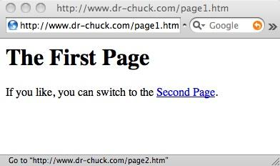
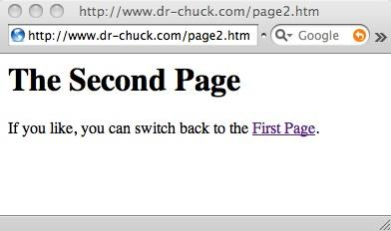
A Web Server
Response
Request
80
<h1>The Second Page</h1><p>If you like, you can switch back to the <a href="page1.htm">First Page</a>.</p>
GET http://www.dr-chuck.com/page2.htm
Browser
Click
Parse/
Render

Slide 14
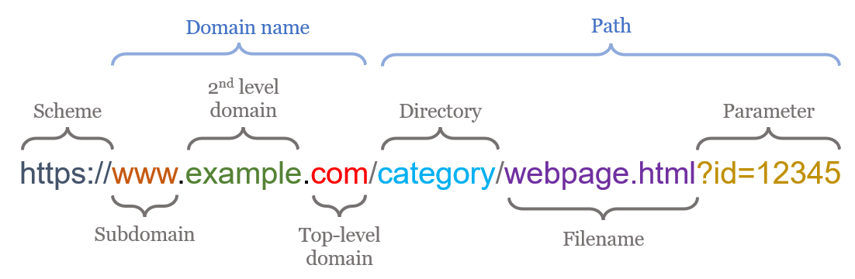

Slide 15
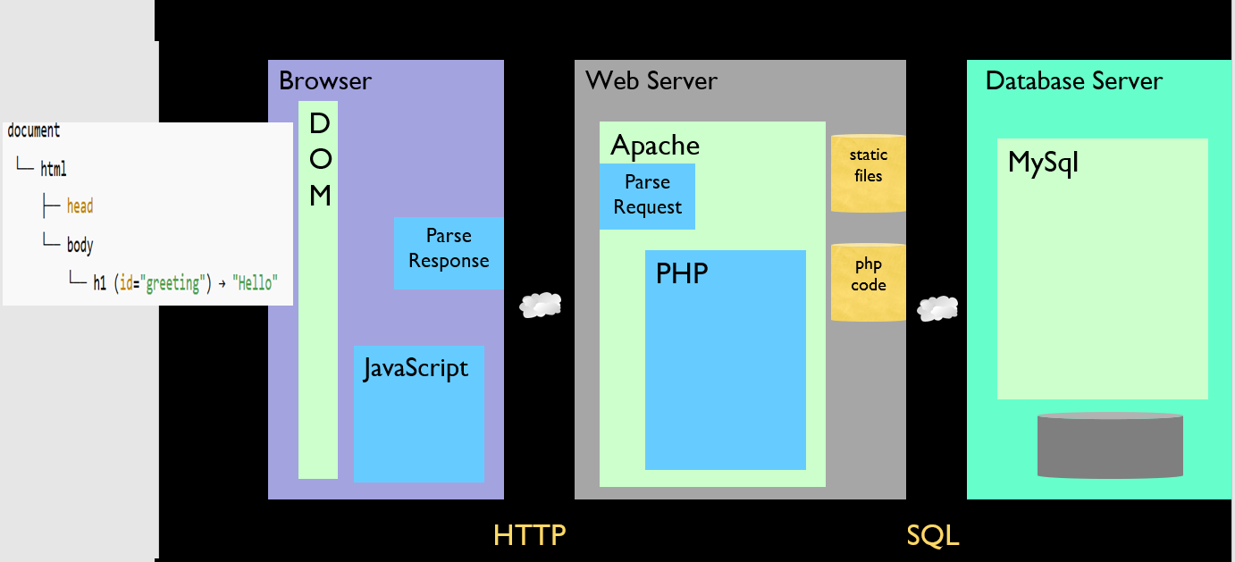

Slide 16
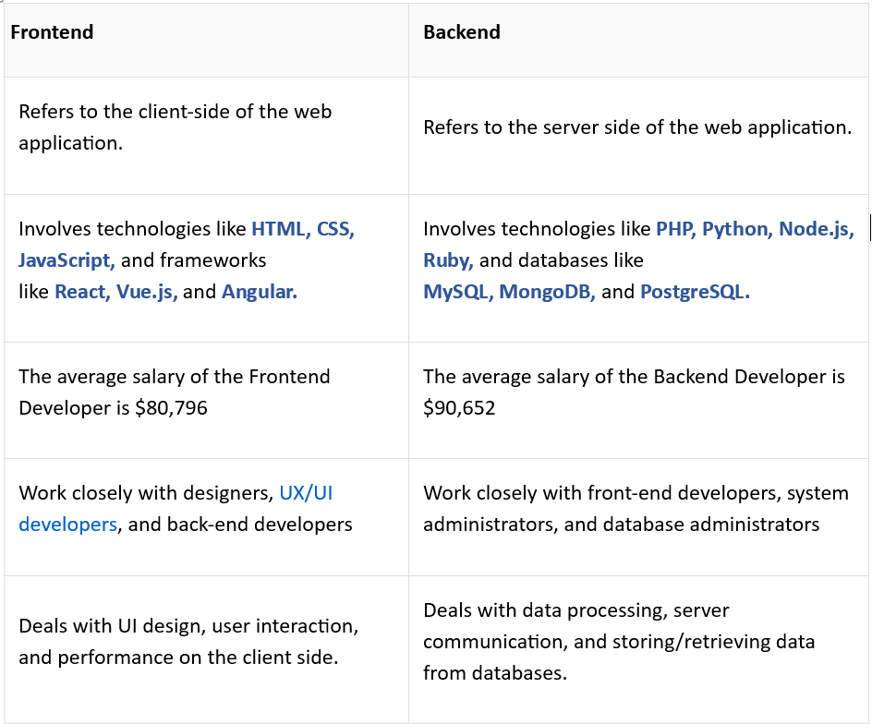
4. Frontend vs Backend Development

Slide 17
Note: Full-stack Development
Full-stack development refers to the development of both the frontend (client-side) and backend (server-side) parts of a web application. A full-stack developer is skilled in both areas and can build a complete web application from start to finish.

Slide 18

HTML Overview
HTML stands for HyperText Markup Language.
It is the standard language used to create and structure content on the web.
What Does HTML Do?
It builds the skeleton of a web page
Tells the browser what to display and how content is organized

Slide 19
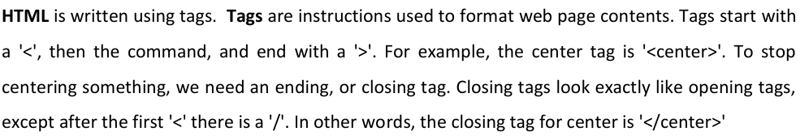
Description of HTML tag

Slide 20
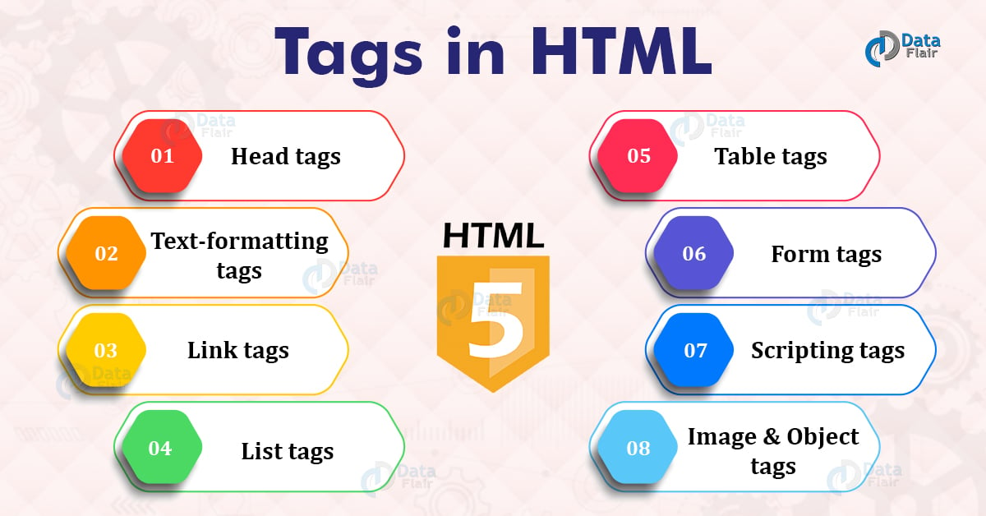

Slide 21
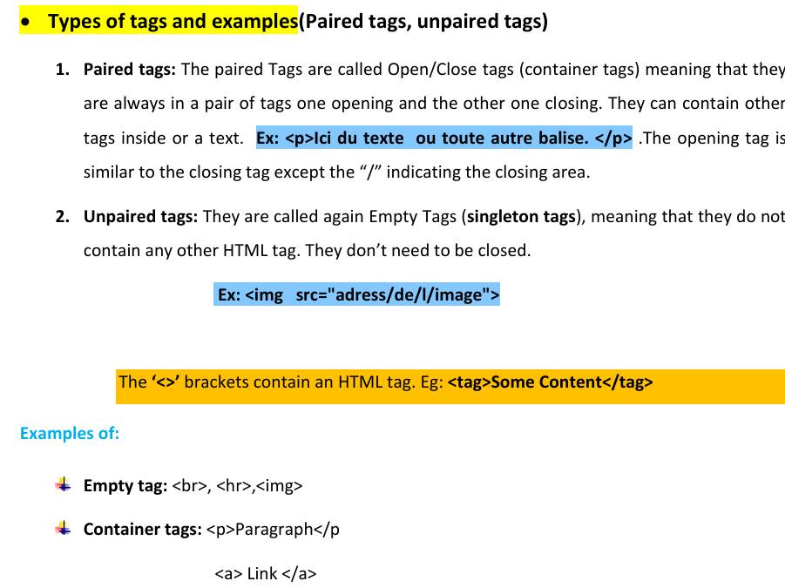

Slide 22

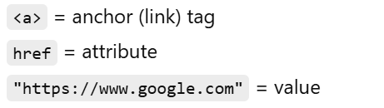
HTML Attributes
HTML attributes are special properties added to HTML elements to provide extra information about them.
Basic Syntax:
Example 1: Link Attribute

Slide 23
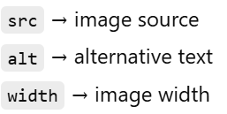
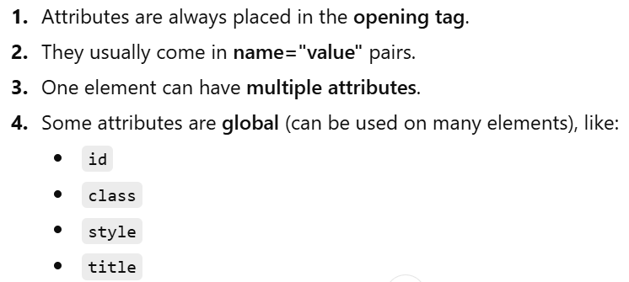

Example 2: Image Attributes
.
Important Points

Slide 24
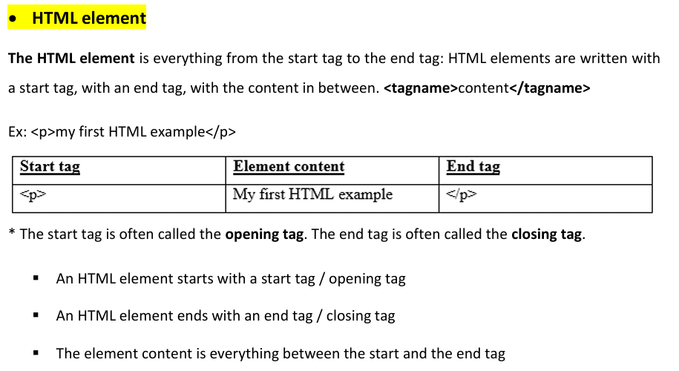


Slide 25
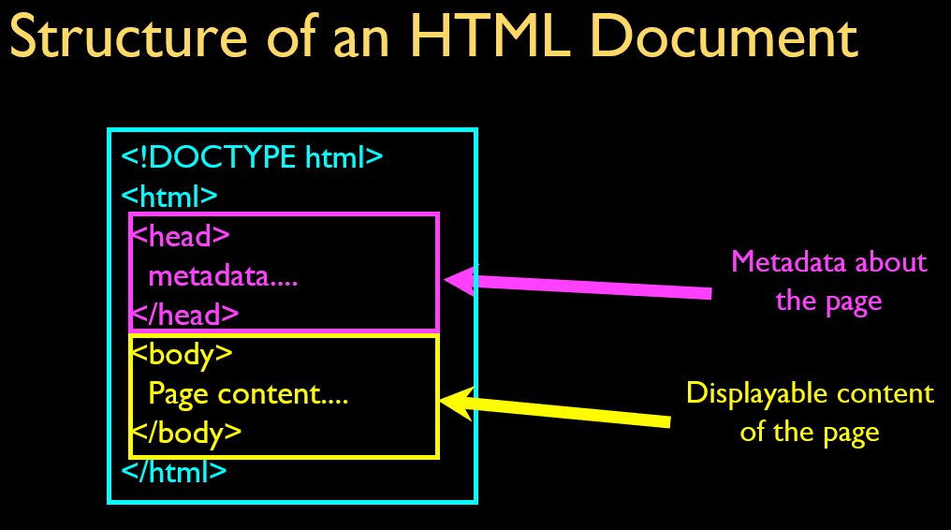
DEVELOPING A WEBPAGE

Slide 26
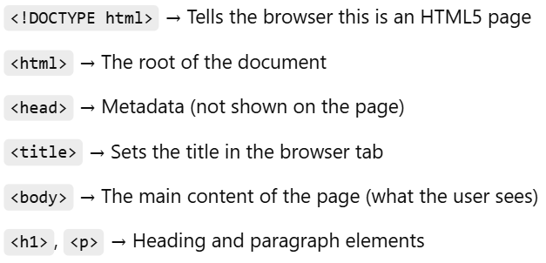
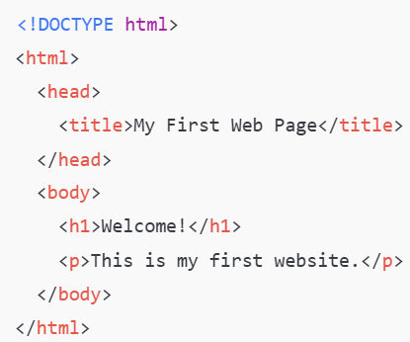

Slide 27
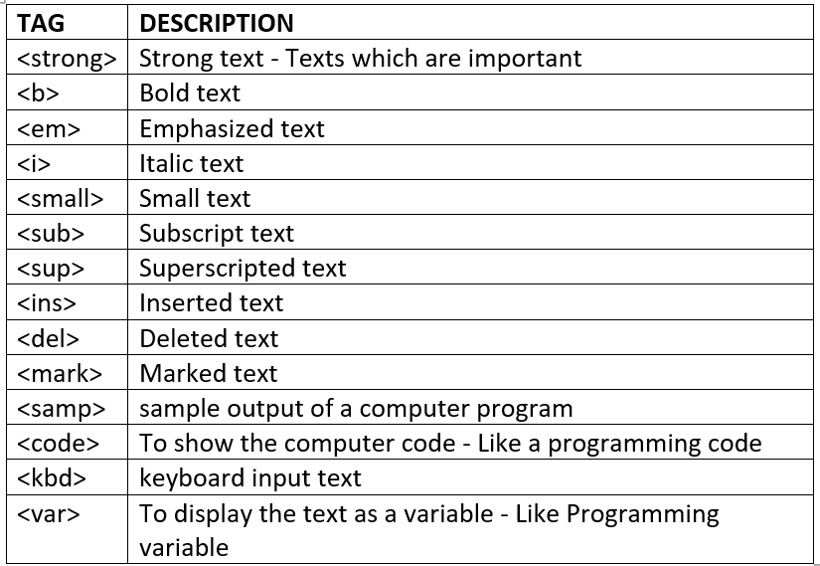
Developing webpage using HTML tag categories
Formatting tags
Formatting tags in HTML are used to enhance the appearance of text and provide emphasis, structure, or meaning. These tags can make text bold, italic, underlined, or styled in other ways.

Slide 28
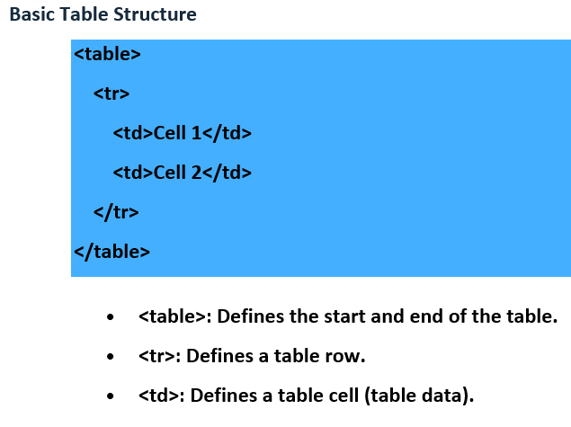
2. Table tags
HTML table tags are used to create tables that display data in rows and columns. An HTML table is created using the <table> tag along with <tr> for table rows, <th> for table headers, and <td> for table data cells. Here's a simple example:

Slide 29
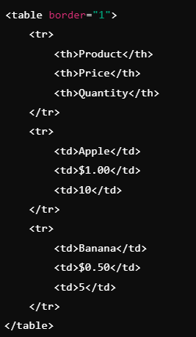

Example1: Sample HTML table

Slide 30
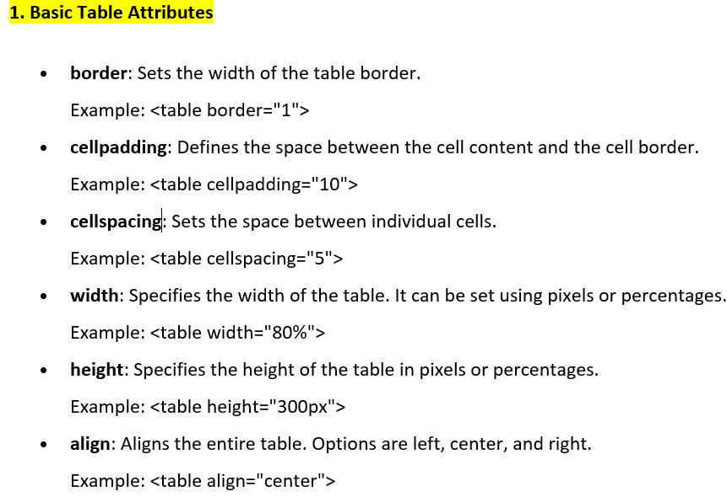
Table attributes

Slide 31
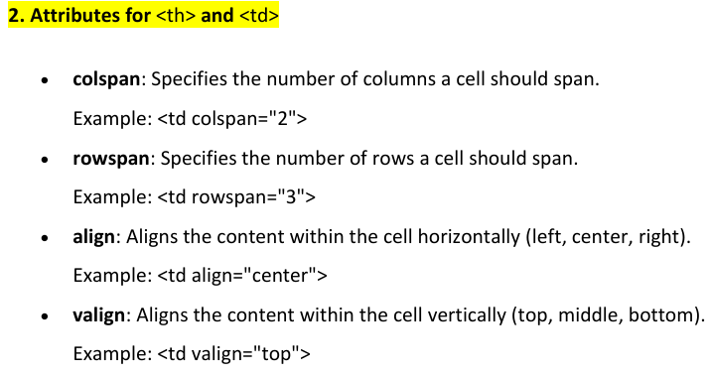

Slide 32
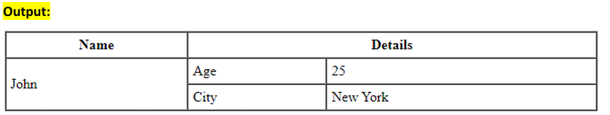
Example:
<table border="1" cellpadding="5" cellspacing="0" width="50%" align="center">
<tr>
<th>Name</th>
<th colspan="2">Details</th>
</tr>
<tr>
<td rowspan="2">John</td>
<td>Age</td>
<td>25</td>
</tr>
<tr>
<td>City</td>
<td>New York</td>
</tr>
</table>

Slide 33
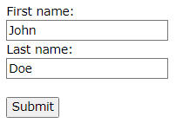
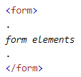
3. Form tags
The HTML <form> tag is used to create an HTML form for collecting user input. Forms are essential for creating interactive web applications and collecting data such as text input, selections, and buttons.

Slide 34
Common Form Elements
Common Form Elements
1. <input>: Creates various types of input fields.
Text field: <input type="text" name="username">
Password field: <input type="password" name="password">
Checkbox: <input type="checkbox" name="subscribe" value="newsletter">
Radio button: <input type="radio" name="gender" value="male">
Submit button: <input type="submit" value="Submit">
File upload: <input type="file" name="upload">

Slide 35
2. <textarea>: Defines a multi-line text input. Example:
<textarea name="comments" rows="4" cols="50"></textarea>
3. <select>: Creates a dropdown list.
Example:
<select name="cars"> <option value="volvo">Volvo</option> <option value="bmw">BMW</option></select>
4. <label>: Provides labels for input elements, improving accessibility.
Example:
<label for="username">Username:</label><input type="text" id="username" name="username">
5. <button>: Defines a clickable button. It can contain text, images, or other content.
Example:
<button type="submit">Submit</button>

Slide 36
Example1:
<!DOCTYPE html>
<html>
<head>
<title>Basic HTML Form</title>
</head>
<body>
<h2>Registration Form</h2>
<form>
<label for="username">Username:</label>
<input type="text" id="username" name="username"><br><br>
<label for="password">Password:</label>
<input type="password" id="password" name="password"><br><br>
<label for="gender">Gender:</label>
<input type="radio" id="male" name="gender" value="male">
<label for="male">Male</label>
<input type="radio" id="female" name="gender" value="female">
<label for="female">Female</label><br><br>

Slide 37
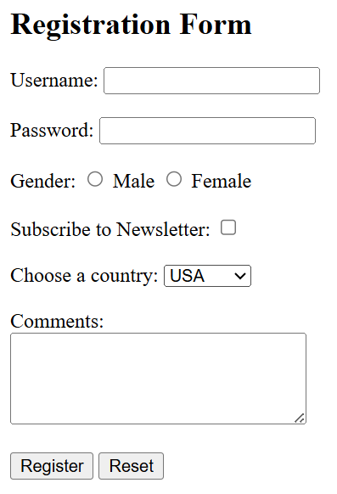
cont’d
<label for="newsletter">Subscribe to Newsletter:</label>
<input type="checkbox" id="newsletter" name="subscribe" value="yes"><br><br>
<label for="country">Choose a country:</label>
<select id="country" name="country">
<option value="usa">USA</option>
<option value="uk">UK</option>
<option value="canada">Canada</option>
</select><br><br>
<label for="comments">Comments:</label><br>
<textarea id="comments" name="comments" rows="4" cols="50"></textarea><br><br>
<input type="submit" value="Register">
<input type="reset" value="Reset">
</form>
</body>
</html>

Slide 38
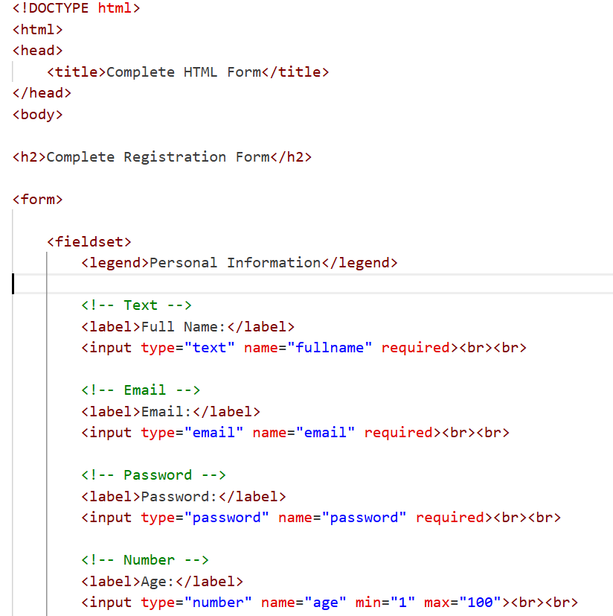
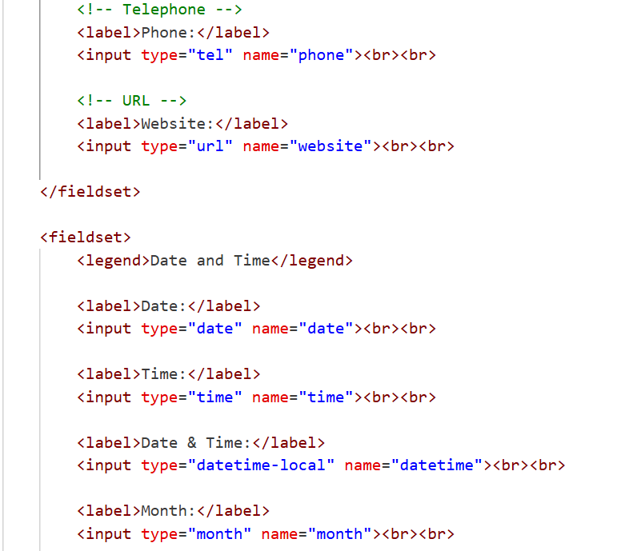
Example2:

Slide 39
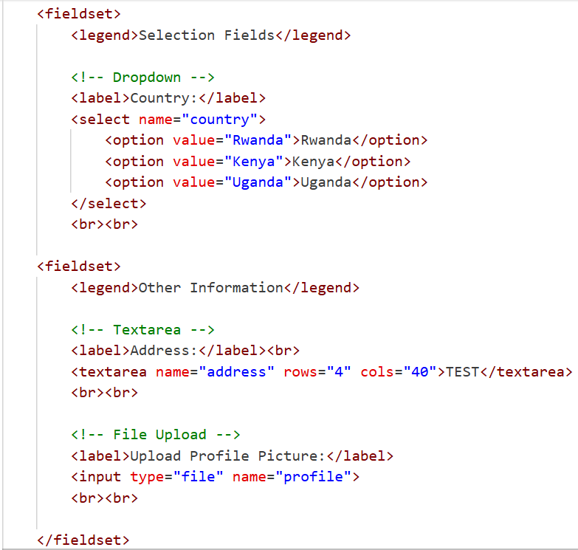
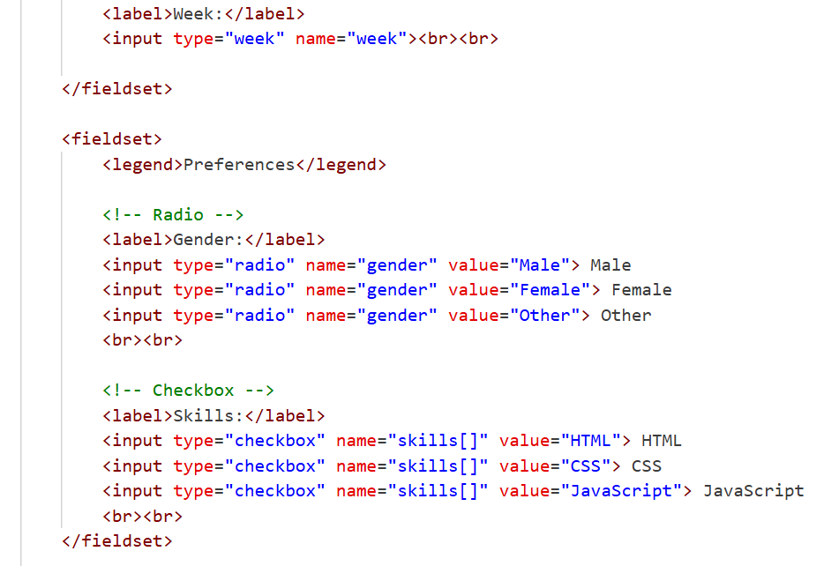
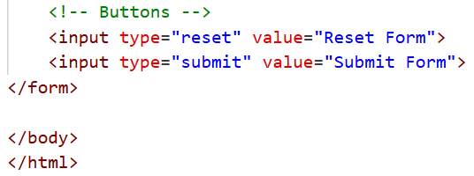
Cont’d

Slide 40
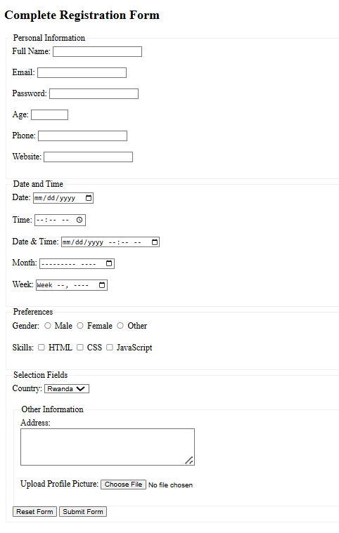
Generated form:

Slide 41
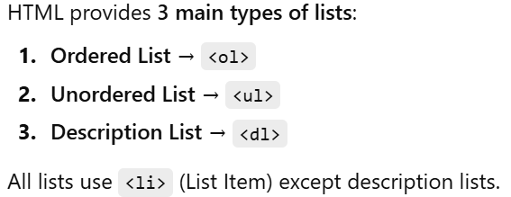
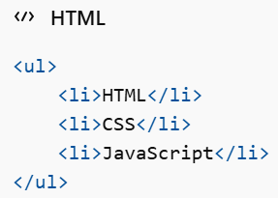
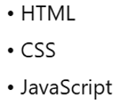
5. Html List Tags: HTML provides several list tags for creating ordered and unordered lists. These tags help organize content into a structured format, making it easier to read and understand.
Output:
Unordered List (<ul>)
Used when order does NOT matter.
Displays items with bullet points.

Slide 42
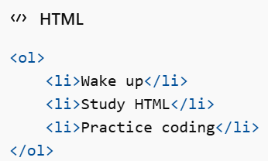
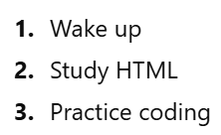
Ordered List (<ol>) Used when order matters (steps, ranking, instructions) = Displays items in a numbered sequence.
Output:

Slide 43
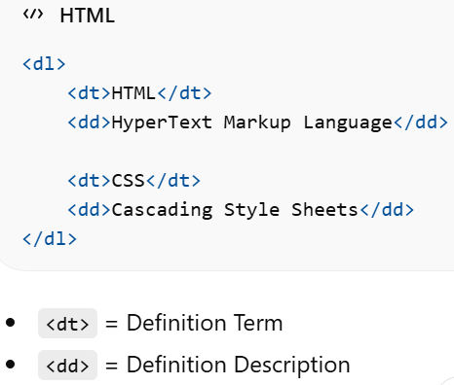
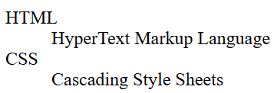
Description List (<dl>) Used for definitions or explanations(Used to create a list of terms and their descriptions).
Output:

Slide 44
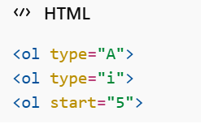
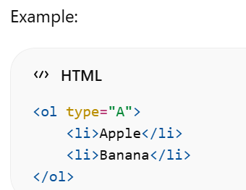
Common Attributes
Important Advice
Many students misuse lists.
Use <ul> for navigation menus
Use <ol> for instructions
Use <dl> for definitions

Slide 45
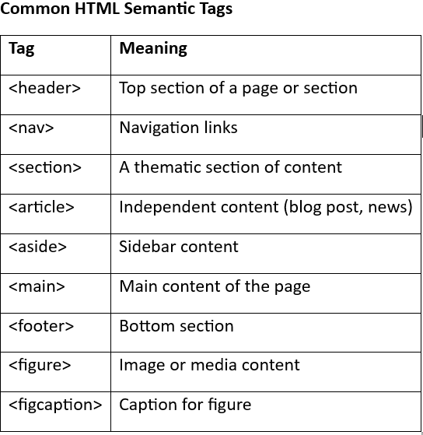
5. Html Semantic Tags
Semantic tags clearly describe the meaning of the content inside them.
Instead of using <div> everywhere, semantic tags tell the browser (and developers, and search engines) what the content represents.

Slide 46
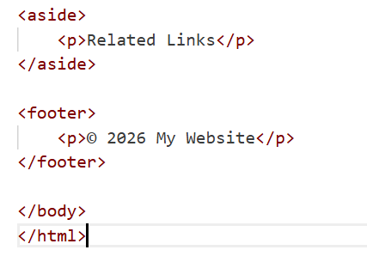
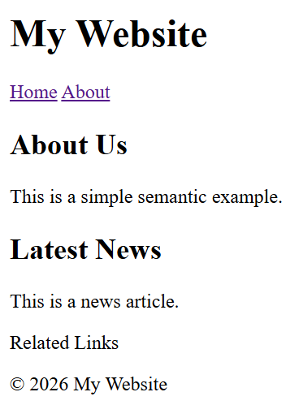
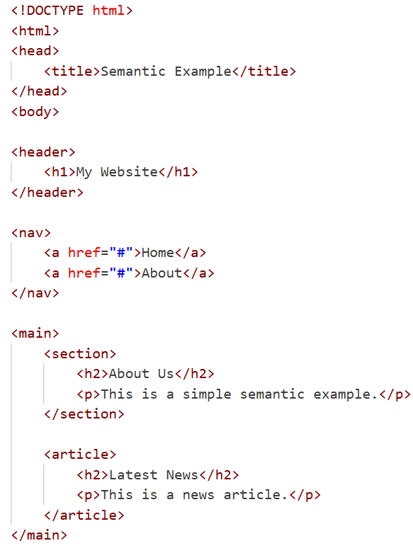
Example 1: Basic Page Structure

Slide 47
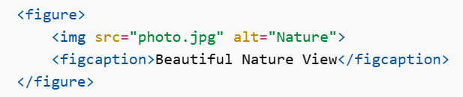
Example 2: Using <figure> and <figcaption>
Why Semantic Tags Matter
Improve SEO
Improve accessibility
Make code clean and readable
Help screen readers understand structure
Follow modern HTML5 standards

Slide 48
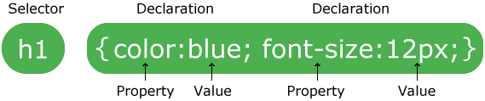
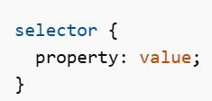
Style web elements using CSS
CSS, stands for Cascading Style Sheets, is a style sheet language used to describe the presentation of a document written in HTML or XML. It allows developers to control the layout, colors, fonts, spacing, and overall visual appearance of web pages
CSS Syntax: CSS syntax consists of two main parts: selectors and declarations.

Slide 49

CSS Selectors The selector determines which HTML elements the style will apply to = CSS selectors are used to "find" (or select) the HTML elements you want to style. For example:

Slide 50


Slide 51


Slide 52




Slide 53


6. The CSS Descendant Selector
The descendant selector selects all elements that are inside a specified element, at any level of nesting.

Slide 54


7. The CSS Child Selector
The child selector (>) selects only elements that are direct children of a specified element.
Explanation: The rule above selects only <p> elements that are immediate (direct) children of a <div>. If the <p> is nested inside another element, it will NOT be selected.

Slide 55


8. The CSS Attribute Selector
The attribute selector selects elements based on the presence or value of an attribute.

Slide 56



The CSS Box Model (Core Concept)

Slide 57



Slide 58


Slide 59



Slide 60


Complete Example

Slide 61

Output:

Slide 62


Note ! That’s a very common and modern practice in CSS. Using the universal selector (*) to apply box-sizing: border-box; ensures every element calculates width and height in the predictable way.
Here’s how it works with your example:

Slide 63

Notes
Auto

Slide 64


Use CSS Visual rules
CSS visual rules allow you to control the appearance of HTML elements, including fonts, text, colors, backgrounds, opacity, and background images. Here’s a breakdown of how to use these visual properties:

Slide 65



Slide 66



Slide 67

In this example, the div will appear semi-transparent.

Slide 68



Slide 69

CSS style types =Ways to Apply CSS
There are three ways to apply CSS in HTML:
CHARACTERISTICS:
Affects only one element
Written inside the HTML tag
Not reusable
Hard to maintain
❌ Not recommended for large projects
✅ Useful for quick testing

Slide 70

CHARACTERISTICS:
Applies to one page only
Good for small projects
Better organization than inline

Slide 71

3. External CSS (Recommended)
CHARACTERISTICS:
Best practice
Reusable across multiple pages
Cleaner structure
Easier maintenance
Faster development for large projects
✅ Used in professional web development

Slide 72

Let’s design

Slide 73



Slide 74


Slide 75

Sample codes
Table codes:

Slide 76


Slide 77



Slide 78

Form codes:

Slide 79



Slide 80


Slide 81
3. Layout Techniques
a) Flexbox
Flexbox means Flexible Box Layout.
It is a CSS layout system used to arrange elements in one direction only:
Either in a row (horizontal)
Or in a column (vertical)
Flexbox is a one-dimensional CSS layout model used to arrange, align, and distribute space among items inside a container.
Example:
.container { display: flex; justify-content: space-between; align-items: center; }
Use cases:
Navigation bars
Centering elements

Slide 82


Example1: Row (Horizontal Layout)

Slide 83

Example2: Column (Vertical Layout)
Now we change the direction.

Slide 84

Clear Comparison
Real-Life Examples
Row Layout (Horizontal)
Navigation bar
Menu items
Buttons in a line
Column Layout (Vertical)
Sidebar menu
Stacked cards
Form fields

Slide 85
Case 1: flex-direction: row; (Default)
Main axis → Horizontal (left ↔ right) Cross axis → Vertical (top ↕ bottom)
So:
justify-content → moves items left, right, center
align-items → moves items up, down, center vertically
Example (Row Direction)
.container { display: flex; justify-content: center; align-items: center; height: 200px; }
Result:
justify-content: center; → centers horizontally
align-items: center; → centers vertically

Slide 86


A complete HTML + CSS example that demonstrates flexbox with flex-direction: row, centering both horizontally and vertically. Here’s a full working example:

Slide 87

Output:

Slide 88
HTML + CSS Menu with Flexbox
<!DOCTYPE html>
<html lang="en">
<head>
<meta charset="UTF-8">
<title>Flexbox Menu Example</title>
<style>
/* Menu container */
.menu {
display: flex; /* Enable flexbox */
justify-content: center; /* Center items horizontally */
align-items: center; /* Align items vertically */
background-color: #333; /* Dark background */
padding: 10px;
}
/* Menu items */
.menu-item {
color: white;
padding: 10px 20px;
margin: 0 5px;
text-decoration: none;
font-weight: bold;
background-color: #444;
border-radius: 4px;
display: flex; /* Flex inside item */
justify-content: center; /* Center text horizontally */
align-items: center; /* Center text vertically */
}
.menu-item:hover {
background-color: #007BFF; /* Hover effect */
}
</style>
</head>
<body>
<h2>Flexbox Menu Example</h2>
<nav class="menu">
<a href="#" class="menu-item">Home</a>
<a href="#" class="menu-item">About</a>
<a href="#" class="menu-item">Services</a>
<a href="#" class="menu-item">Contact</a>
</nav>
</body>
</html>

Slide 89

Output:

Slide 90
b) CSS Grid
1. Definition
CSS Grid is a layout system in CSS that allows you to create complex, responsive, two‑dimensional layouts (rows and columns).
Unlike Flexbox (which is one‑dimensional), Grid handles both rows and columns simultaneously.

Slide 91



Slide 92

Output:

Slide 93
2. Code Explanation
css
.container {
display: grid; /* Enables grid layout */
grid-template-columns: repeat(3, 1fr); /* Creates 3 equal-width columns */
gap: 10px; /* Adds spacing between grid items */
}
display: grid; → turns the container into a grid layout.
grid-template-columns: repeat(3, 1fr); → defines 3 columns, each taking equal space (1fr = one fraction of available space).
gap: 10px; → sets spacing between rows and columns (like margins between items).
3. Key Concepts
Grid Container: The parent element with display: grid.
Grid Items: The child elements inside the container.
Fraction Unit (fr): Represents a portion of available space.
Repeat Function: Simplifies repetitive column/row definitions.
Gap: Controls spacing between items without needing margins.
4. Advantages
Easy to create responsive layouts.
Handles both rows and columns in one system.
Cleaner and more flexible than floats or tables.

Slide 94
Output
Items are arranged in a grid with 3 columns per row.
Perfect for dashboards, galleries, structured layouts.

Slide 95





Slide 96



Slide 97

CSS Media Queries – Summary Notes
1. Definition
Media queries are CSS techniques that allow you to apply styles based on the device’s characteristics, such as screen size, resolution, or orientation.
Essential for responsive web design (making websites look good on phones, tablets, desktops).

Slide 98


Slide 99
4. Example: Responsive Layout
/* Default styles for desktop */ body { background-color: lightblue; font-size: 18px; } /* Styles for tablets (max-width 768px) */ @media (max-width: 768px) { body { background-color: lightgreen; font-size: 16px; } } /* Styles for mobile (max-width 480px) */ @media (max-width: 480px) { body { background-color: lightpink; font-size: 14px; } }
What happens:
Desktop → light blue, 18px font.
Tablet → light green, 16px font.
Mobile → light pink, 14px font.

Slide 100
5. Tips
Use mobile-first approach: write default styles for mobile, then add min-width queries for bigger screens.
Combine multiple conditions:
@media (min-width: 600px) and (max-width: 900px) {
body { background-color: orange; }
}
Can be used for fonts, layouts, images, visibility, and almost any CSS property.
Works in external CSS, internal CSS, or inline style blocks.

Slide 101

JavaScript
1. Introduction
JavaScript is a lightweight, cross-platform, interpreted programming language mainly used for web development.
It runs inside the browser using <script> tags and enables interactive and dynamic content on websites.
JavaScript can manipulate HTML and CSS dynamically.
Although it runs inside browsers, it can also be used on servers through Node.js.

Slide 102
2. Key Features
Lightweight & Fast: Executes quickly in browsers.
Single‑Threaded: Handles one task at a time, but supports asynchronous operations (Promises, async/await).
Event‑Driven: Responds to user actions like clicks, key presses, or form submissions.
Cross‑Platform: Works across different operating systems and browsers.

Slide 103
3. Basic Concepts
Variables= A variable is a named container used to store data in memory.
Declared using var, let, or const.
var → function‑scoped, older style.
let → block‑scoped, allows reassignment.
const → block‑scoped, cannot be reassigned.
Example:
let name = "Betty";
const age = 25;
var city = "Kigali";

Slide 104
B. Data Types
Primitive types: String, Number, Boolean, Null, Undefined.
Reference types: Objects, Arrays, Functions.
Example:
let text = "Hello"; // String
let number = 10; // Number
let isActive = true; // Boolean
let items = [1, 2, 3]; // Array
let person = {name:"Vivian", age:22}; // Object

Slide 105
C. Operators
Arithmetic: +, -, *, /
Comparison: == (loose), === (strict), !=, >, <
Logical: && (AND), || (OR), ! (NOT)
Example1:
console.log(5 + 3); // 8
console.log(5 === "5"); // false
console.log(true && false); // false

Slide 106

Example2:

Slide 107

Notes
There are several ways to print JavaScript output on the screen in a browser. Let’s go through them with examples:
Using document.write()
Prints directly into the HTML document.
Simple, but not recommended for modern projects because it can overwrite the page if used after loading.
Example:

Slide 108

2. Using innerHTML
Updates the content of an existing HTML element.
Most common way to print variables on screen.
Example:

Slide 109

3. Using alert()
Displays output in a popup dialog box.
Good for quick testing, but not for user‑friendly interfaces.
Example:

Slide 110

4. Using console.log()
Prints output to the browser console (not visible on the page).
Best for debugging.
Example:

Slide 111


Comparison of Methods

Slide 112

There are 3 main ways to place JavaScript in HTML:
Inside <head>
(Not Always Recommended)

Slide 113

2. Before </body> (BEST PRACTICE)

Slide 114

3. External JavaScript File (PROFESSIONAL WAY)
Why this is better:
Cleaner HTML
Reusable JavaScript
Easier to maintain
Better for large projects

Slide 115

Bonus: Using defer in <head> (Modern Way)
You can safely put JS in <head> like this:
<head> <script src="script.js" defer></script> </head>
What defer does:
Downloads JS immediately
Executes it only after HTML is fully loaded
This is very professional and widely used.

Slide 116

The different ways JavaScript can interact with users, mainly using alert(), confirm(), and prompt(). These are built-in dialog functions for quick input/output. Let me explain clearly:
alert()
Purpose: Show a message to the user.
Doesn’t get any input — only displays text.
alert("Hello! Welcome to the website.");
Shows a popup with an OK button.
Example with user input: just for notification, not data.
2. confirm()
Purpose: Ask the user a Yes/No (OK/Cancel) question.
Returns: true if user clicks OK, false if Cancel.
let result = confirm("Do you want to continue?"); if (result) { alert("You clicked OK!"); } else { alert("You clicked Cancel!"); }
Useful for confirming actions like deleting a record.

Slide 117
3. prompt()
Purpose: Ask the user to enter a value.
Returns: The string entered by the user (or null if Cancel).
let name = prompt("Enter your name:"); if (name) { alert("Hello, " + name + "!"); } else { alert("You didn’t enter your name."); }

Slide 118
Example:
<!DOCTYPE html>
<html lang="en">
<head>
<meta charset="UTF-8">
<title>Age Comparison</title>
</head>
<body>
<script>
// Ask user for their age
let age = prompt("Enter your age:");
// Convert input to number
age = parseInt(age);
// Check if the user entered a valid number
if (isNaN(age)) {
alert("Please enter a valid number!");
} else {
// Compare age
if (age >= 18) {
alert("You are an adult.");
} else {
alert("You are not an adult yet.");
}
}
</script>
</body>
</html>

Slide 119

D. Functions
A function is a reusable block of code designed to perform a specific task(Instead of repeating code, you write it once and call it whenever needed).
Declared with function or arrow syntax ()=>{}.
Basic Syntax: Normal Function
function functionName() {
// code to execute
}

Slide 120
Function with Parameters
Parameters are variables passed into a function.
function greet(name) {
console.log("Hello " + name);
}
greet("Jean");
greet("Alice");
name is a parameter. "Jean" is an argument.

Slide 121

Arrow Functions (Modern JavaScript – ES6)
Very important for React (you’re learning React, so focus here).
Basic Arrow Function:

Slide 122
E. Arrays
Ordered lists of values.
Can store multiple data with the same type.
Example:
let fruits = ["Apple", "Banana", "Mango"];
console.log(fruits[1]); // Banana

Slide 123
Example:
<!DOCTYPE html>
<html>
<head>
<title>JavaScript Array Example</title>
</head>
<body>
<h2>Output</h2>
<script>
// Create an array
let fruits = ["Apple", "Banana", "Mango"];
document.write("Original array:"+"<br>");
document.write(fruits +"<br>");
// Print one element (index 1)
document.write("Second fruit:"+"<br>");
document.write(fruits[1] +"<br>");
//Print all elements using a loop
document.write("All fruits:" +"<br>");
for (let i = 0; i < fruits.length; i++) {
document.write(fruits[i] +"<br>");
}
</script>
</body>
</html>

Slide 124
F. Objects
Collections of key‑value pairs.
Useful for modeling real‑world entities.
Example:
let student = {
name: "Vivian",
age: 22,
course: "IT"
};
console.log(student.name); // Vivian

Slide 125
Example:
<!DOCTYPE html>
<html>
<head>
<title>Book Object Example</title>
</head>
<body>
<h2>Output</h2>
<script>
//Create book object
let book = {
title: "Introduction to JavaScript",
author: "John Smith",
year: 2023,
pages: 350
};
//Access individual properties
document.write("Title:" +book.title +"<br>");
document.write("Author:" +book.author +"<br>");
document.write("All Book Information:<br>");
for (let key in book) {
document.write(key + ": " + book[key] + "<br>");
}
</script>
</body>
</html>

Slide 126
JavaScript Control Structures
Conditional: if, else, switch
Loops: for, while, do...while
Example:
let score = 85;
if (score >= 90) {
console.log("Grade A");
} else {
console.log("Grade B");
}
for (let i = 0; i < 5; i++) {
console.log(i);
}

Slide 127
Example1 on condition
<!DOCTYPE html>
<html lang="en">
<head>
<meta charset="UTF-8">
<title>Conditional Example</title>
</head>
<body>
<script>
// Example: if...else
let age = 18;
if (age >= 18) {
console.log("You are an adult.");
} else {
console.log("You are a minor.");
}
</script>
</body>
</html>

Slide 128
Example2 on loops
<!DOCTYPE html>
<html lang="en">
<head>
<meta charset="UTF-8">
<title>For Loop Example</title>
</head>
<body>
<script>
// Example: printing numbers from 1 to 5
for (let i = 1; i <= 5; i++) {
console.log("Number: " + i);
}
</script>
</body>
</html>

Slide 129

The HTML DOM (Document Object Model)
Is a structured representation of a web page that allows developers to access, modify, and control its content and structure using JavaScript. It powers most dynamic website interactions, enabling features like real-time updates, form validation, and interactive user interfaces.

Slide 130


Slide 131
Notes
The HTML Document Object Model (DOM) is a tree structure, where each HTML tag becomes a node in the hierarchy.
At the top, the <html> tag is the root element, containing both <head> and<body> as child elements.
These in turn have their own children, such as <title>, <div>, and nested elements like <h1>, <p>,<ul>, and<li>.
Elements that contain other elements are labeled as container elements, while elements that do not are simply child elements.
This hierarchy allows developers to navigate and manipulate web page content using JavaScript by traversing from parent to child and vice versa.

Slide 132


Slide 133
DOM Manipulation
Access and modify HTML elements.
Common methods: getElementById, querySelector, innerHTML.
Examples:
<p id="demo">Original Text</p>
<script>
document.getElementById("demo").innerHTML = "Text Changed!";
</script>
Key Idea
getElementById → fast, only id.
querySelector → flexible, any CSS selector, first match.
innerHTML → not a selector, used to read/change the content inside an element.
<p id="demo">Original Text</p>
<script>
// Using querySelector to select by ID
document.querySelector("#demo").innerHTML = "Text Changed!";
</script>

Slide 134
Selecting and modify elements using DOM
getElementById("id") = is a method of the document object.
Selects a single element by its unique ID.
Returns one element (or null if not found).
Important Points
Selects only by id
Returns one element
Faster (because IDs are unique)
You write only the ID name (NO #)
Cannot select class, tag, or complex selectors
Example:
<p id="demo">Hello</p>
<script>
let element = document.getElementById("demo");
</script>

Slide 135


Slide 136
2. querySelector() = querySelector() is a modern method that uses CSS selectors to select elements.
Example (ID)
let element = document.querySelector("#title");
Notice the # — because it uses CSS selector rules.
Example (Class)
<p class="text">Hello</p>
let element = document.querySelector(".text");
Example (Tag)
let element = document.querySelector("p");
✔ Key Points
Uses CSS selector syntax
Can select:
id (#id)
class (.class)
tag (div)
attribute (input[type="text"])
Returns only the first matching element

Slide 137

When Should You Use Each?
If you are selecting only by ID, getElementById() is simple and slightly faster.
If you want flexibility (class, tag, complex selector), use querySelector().

Slide 138
Example Comparison
<div id="box" class="container">Box</div>
<div class="container">Another Box</div>
<input type="text" name="username">
<script>
// Traditional methods
let byId = document.getElementById("box"); // single element
let byTag = document.getElementsByTagName("div"); // all <div> elements
let byClass = document.getElementsByClassName("container"); // all with class
let byName = document.getElementsByName("username"); // input with name
// Modern methods
let qId = document.querySelector("#box"); // first element with id=box
let qClass = document.querySelector(".container"); // first element with class
let qAllClass = document.querySelectorAll(".container"); // all with class
let qName = document.querySelector("input[name='username']"); // first input with name
</script>

Slide 139
Key Takeaways
Traditional methods are older and more specific (ID, class, tag, name).
querySelector is more powerful because it uses CSS selectors and works for all cases.
Best practice today: use querySelector / querySelectorAll for flexibility, unless you specifically need the older methods.

Slide 140

Manipulating elements’ styles in JavaScript
1. Inline Style Changes
Use the .style property to directly change CSS of an element.

Slide 141
Using getElementById()
<!DOCTYPE html>
<html>
<head>
<title>Auto Style Change</title>
</head>
<body>
<h1 id="title">Hello JavaScript</h1>
<script>
let element = document.getElementById("title");
element.style.color = "white";
element.style.backgroundColor = "green";
element.style.fontSize = "40px";
element.style.padding = "20px";
</script>
</body>
</html>

Slide 142
Using querySelector()
<!DOCTYPE html>
<html>
<head>
<title>Auto Style Change</title>
</head>
<body>
<h1 id="title">Hello JavaScript</h1>
<script>
let element = document.querySelector("#title");
element.style.color = "white";
element.style.backgroundColor = "green";
element.style.fontSize = "40px";
element.style.padding = "20px";
</script>
</body>
</html>

Slide 143
JavaScript Events
What is an Event?
An event is an action that happens in the browser.
It can be:
A user action (click, type, hover)
A browser action (page load, resize)
JavaScript can detect these actions and respond to them.

Slide 144
Common Types of Events
click
dblclick
mouseover
mouseout
Most common in practice: click, keydown, submit, load, scroll.

Slide 145
JavaScript event handlers = onclick and addEventListener
onclick and addEventListener are called event handlers (or event listener methods) in JavaScript.
They are ways to bind code to events so that when something happens (like a click), your function runs.
Terminology
Event → The action that happens (e.g., click, keydown, submit).
Event Handler / Event Listener → The function that responds to the event.
Event Binding → The process of connecting an event to a handler.

Slide 146
1. onclick Syntax
Inline in HTML:
<button onclick="alert('Button clicked!')">Click Me</button>
In JavaScript:
<button id="btn">Click Me</button> <script> // Using querySelector to select the button by ID document.querySelector("#btn").onclick = function() { alert("Button clicked!"); }; </script>

Slide 147
Explanation
document.querySelector("#btn") → selects the button with id="btn".
.onclick = function() { ... } → assigns an anonymous function (no name) to run when the button is clicked.
alert("Button clicked!") → shows a pop-up when the button is clicked.

Slide 148
Example
<!DOCTYPE html>
<html lang="en">
<head>
<meta charset="UTF-8">
<title>onclick Example</title>
</head>
<body>
<h2>onclick Demo</h2>
<!-- Button with inline onclick -->
<button onclick="alert('Button clicked!')">Click Me</button>
</body>
</html>

Slide 149
<!DOCTYPE html>
<html lang="en">
<head>
<meta charset="UTF-8">
<title>onclick Example</title>
</head>
<body>
<h2>onclick Demo</h2>
<!-- Button without inline onclick -->
<button id="myButton">Click Me</button>
<script>
// Get the button element
const button = document.getElementById("myButton");
// Assign the onclick property in JavaScript
button.onclick = function() {
alert("Button clicked!");
};
</script>
</body>
</html>

Slide 150
2. addEventListener
Syntax (General Form)
document.querySelector("CSS_SELECTOR").addEventListener("EVENT_TYPE", function() { // Code to run when the event happens });
.addEventListener("EVENT_TYPE", function() {...})
"EVENT_TYPE" → the type of event you want to listen for (click, mouseover, keypress, etc.)
function() {...} → anonymous function that runs when the event happens

Slide 151
Example addEventListener
<button id="btn">Click Me</button> <script> // Directly attach the event listener without storing in a variable document.querySelector("#btn").addEventListener("click", function() { alert("Button clicked!"); }); </script>
Explanation
document.querySelector("#btn") → selects the button directly.
.addEventListener("click", function() { ... }) → attaches the click event immediately.
No need for let button = ... unless you want to reuse it later.

Slide 152

A complete example

Slide 153
2. Hide/Show with Styles
<div id="box">This is a box</div>
<button onclick="document.getElementById('box').style.display='none'">Hide</button>
<button onclick="document.getElementById('box').style.display='block'">Show</button>
Here, the display property is manipulated to hide/show the element.

Slide 154
<!DOCTYPE html>
<html>
<head>
<title>Hide and Show Example</title>
<style>
#box {
width: 300px;
height: 150px;
background-color: lightblue;
text-align: center;
line-height: 150px;
font-size: 20px;
margin-bottom: 20px;
}
button {
padding: 10px 20px;
margin-right: 10px;
font-size: 16px;
}
</style>
</head>
<body>
<div id="box">This is a box</div>
<button onclick="document.getElementById('box').style.display='none' "> Hide</button>
<button onclick="document.getElementById('box').style.display='block' ">Show </button>
</body>
</html>

Slide 155

Using JavaScript

Slide 156

Notes: you can prefer to use: in order to control the transition of elements
classList.add and classList.remove are JavaScript methods used to manipulate CSS classes on HTML elements. They are part of the classList property of an element, which gives you a convenient way to add, remove, toggle, or check CSS classes without touching the entire className string.

Slide 157
How It Works
Base State (hidden) Define the element’s default style (e.g., opacity: 0, transform: translateY(-20px)).
Active State (visible) Create a CSS class (e.g., .show) that changes the properties (opacity: 1, transform: translateY(0)).
Transition Add a transition property in CSS so changes between states animate smoothly.
JavaScript Control
Use element.classList.add("show") to apply the visible state.
Use element.classList.remove("show") to revert to the hidden state.

Slide 158
A simple example
<!DOCTYPE html>
<html lang="en">
<head>
<meta charset="UTF-8">
<meta name="viewport" content="width=device-width, initial-scale=1.0">
<title>Document</title>
<style>
.box{
background-color: skyblue;
color: aliceblue;
width: 300px;
width: 100px;
margin: 0 auto;
opacity: 0;
transition: opacity 1s ease;
}
.box.show{
opacity: 1;
transition: opacity 0.5s ease;
}
</style>
</head>
<body>
<button onclick="document.getElementById('mybox').classList.add('show')">Open</button>
<div class="box" id="mybox">
<h1>THIS IS MY BOX</h1>
<button onclick="document.getElementById('mybox').classList.remove('show')">Close</button>
</div>
</body>
</html>

Slide 159
Improved transition example
.box.show {
opacity: 1;
transform: translateY(0); /* slide into place */
pointer-events: auto;
}
button {
margin: 10px;
padding: 8px 12px;
border: none;
border-radius: 4px;
background-color: black;
color: white;
cursor: pointer;
}
.close-btn {
background-color: crimson;
}
</style>
</head>
<body>
<button onclick="document.getElementById('mybox').classList.add('show')">Open</button>
<div class="box" id="mybox">
<h1>THIS IS MY BOX</h1>
<button class="close-btn" onclick="document.getElementById('mybox').classList.remove('show')">Close</button>
</div>
</body>
</html>
<!DOCTYPE html>
<html lang="en">
<head>
<meta charset="UTF-8">
<meta name="viewport" content="width=device-width, initial-scale=1.0">
<title>Improved Transition</title>
<style>
.box {
background-color: skyblue;
color: white;
width: 300px;
margin: 20px auto;
padding: 20px;
text-align: center;
/* hidden by default */
opacity: 0;
transform: translateY(-30px); /* slide up */
transition: opacity 0.8s ease, transform 0.8s ease;
pointer-events: none; /* prevent clicks when hidden */
}

Slide 160
How These Properties Work Together
Example hidden element:
.box{ opacity: 0; transform: translateY(-30px); transition: opacity 0.8s ease-in-out, transform 0.8s ease; pointer-events: none; }
Meaning:
Form is invisible
Form is moved upward
Form cannot be clicked
When it appears, animation will be smooth
Example visible form:
.form.show { opacity: 1; transform: translateY(0); pointer-events: auto; }
Result:
Form slides down
Form fades in
Form becomes clickable

Slide 161


A simple Dashboard Example (using onclick)

Slide 162


Slide 163


Slide 164
Key Take away:
First, select the element (getElementById, querySelector, etc.).
Then, manipulate it using content, style, attributes, classes, or events.
This is how you make web pages dynamic and interactive.

Slide 165
JavaScript Form Validation on Button Click – Summary Notes
1. Purpose
Ensure that users enter correct and complete data before submission.
Prevent submission if validation fails.
Improve user experience and data integrity.
2. Basic Steps
Select the form and button in JavaScript.
Add an event listener to the button (usually click).
Check the input fields for validity.
Show error messages if data is invalid.
Prevent form submission if validation fails.

Slide 166
3. Common Validation Types
Required fields: Ensure a field is not empty.
Length check: Minimum or maximum character length.
Pattern check: Match specific patterns like email, phone number, or password.
Numeric check: Validate numbers, age, etc.
Matching fields: Confirm password matches.

Slide 167
4. Example: Simple Validation
<form id="myForm"> Name: <input type="text" id="name"><br> Email: <input type="email" id="email"><br> <button type="submit" id="submitBtn">Submit</button> </form> <script> document.getElementById('submitBtn').addEventListener('click', function(event) { let name = document.getElementById('name').value; let email = document.getElementById('email').value; if (name === "") { alert("Name is required!"); event.preventDefault(); // Stop form submission } else if (email === "") { alert("Email is required!"); event.preventDefault(); } else { alert("Form submitted successfully!"); } }); </script>

Slide 168
Complete example
<script>
document.getElementById('submitBtn').addEventListener('click', function(event) {
let name = document.getElementById('name').value;
let email = document.getElementById('email').value;
if (name === "") {
alert("Name is required!");
event.preventDefault(); // Stops the form from submitting
} else if (email === "") {
alert("Email is required!");
event.preventDefault();
} else {
alert("Form submitted successfully!");
}
});
</script>
</body>
</html>
<!DOCTYPE html>
<html lang="en">
<head>
<meta charset="UTF-8">
<title>Simple Form Validation</title>
</head>
<body>
<h2>Registration Form</h2>
<form id="myForm">
Name: <input type="text" id="name"><br><br>
Email: <input type="email" id="email"><br><br>
<button type="submit" id="submitBtn">Submit</button>
</form>

Slide 169
END OF CHAP 1

